Slide 1
MARC (MODERNIZED APPLICATION FOR RELIABLE CONSTRUCTION)

Slide 2
MARC - DESCRIPTION
MARC provides a unified platform to manage and track all construction activities, ensuring streamlined operations and reducing inefficiencies in project workflows.
The platform enhances workflow efficiency by automating processes, reducing administrative burdens, and enabling contractors to focus on critical construction tasks.
MARC bridges communication gaps between contractors, managers, and engineers, fostering seamless collaboration and timely decision-making throughout project phases.
Real-time tracking and analytics features enable contractors to monitor progress, identify bottlenecks, and make informed adjustments to stay on schedule and within budget.

Slide 3
TEAM MEMBERS
Akassh Paramasivan
Ramya Karuthappandian
Jayanth Mani
Adharsh Rengarajan

Slide 4
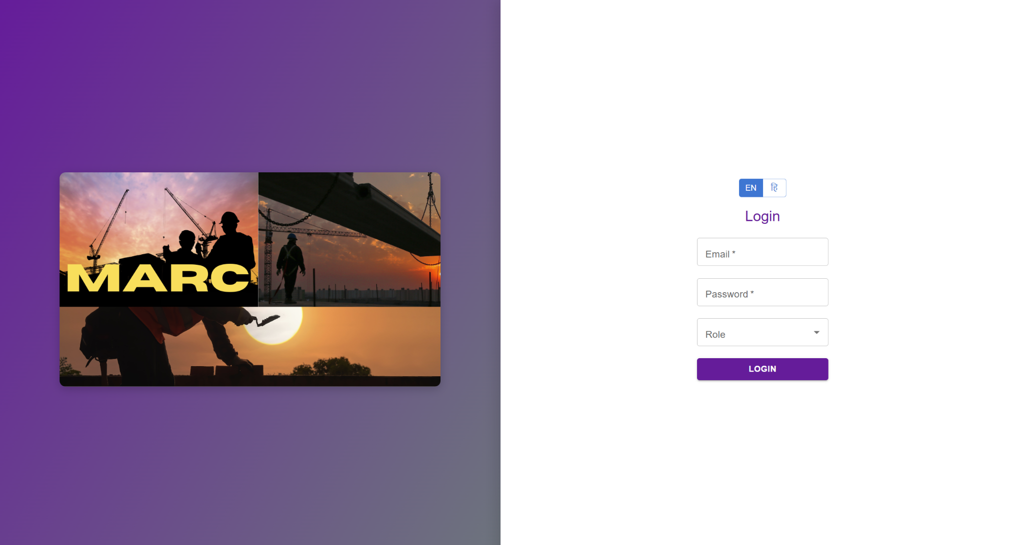
UI SCREENSHOTS

